Slide 1
Online Analytic Processing
COMP323 Chapter 4

Slide 2
Outline
Sequence of queries in a typical analysis session
OLAP features:
Multidimensional data analysis
Complex calculation
Speed of thought
OLAP architecture
Client and server
XMLA and MDX
Defining a cube
MDX basics
Notes:
Read Chap 1 in Rizzi, Chap 15 in Ponniah

Slide 3
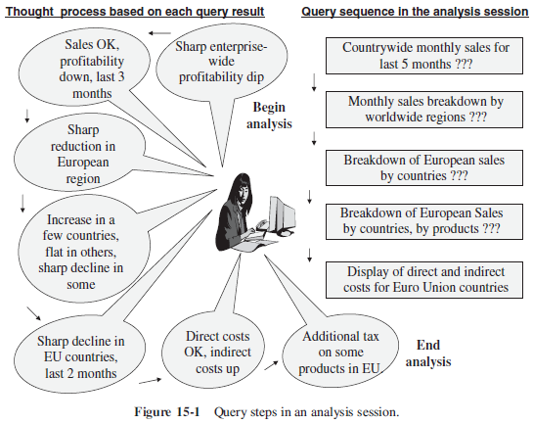
A Typical Analysis Session

Slide 4
Queries in a Typical Analysis Session
Why profitability dipped sharply in recent months in the entire enterprise?
What are the overall sales for the last five months for the entire company, broken down by individual months?
The sales do not show a drop, but there is a sharp reduction in profitability for the last three months.
Give me a breakdown of monthly sales by major worldwide regions.
The European region is responsible for the reduction in profitability.
Give me a breakdown of European sales by individual countries.
Profitability has increased for a few countries, decreased sharply for some other countries, and been stable for the rest.
Give me a breakdown of profitability for the European countries by country, month, and product.
Very sharp decline in profitability for the last two months for some products in the countries.
Display the direct and indirect costs for European countries of those products.
Direct costs (e.g. manufacturing) remain at the usual levels, but the indirect costs have shot up.
The decline is due to additional tax levies on some products in the EU.

Slide 5
Online Analytical Processing
Online Analytical Processing (OLAP) is a category of software technology that enables analysts, managers and executives to gain insight into data through fast, consistent, interactive access in a wide variety of possible views of information that has been transformed from raw data to reflect the real dimensionality of the enterprise as understood by the user. (from OLAP council)

Slide 6
Multidimensional Data Analysis
Multidimensional data analysis supports complex analysis along several business dimensions, at any level of aggregation, and provide a multidimensional view of data
Multidimensional data model conforms to how the users perceive business problems.
Able to handle multidimensional query (e.g., "how much revenue did the new product X generate during the last three months, broken down by individual months, in the south central territory, by individual stores, broken down by promotions, compared to estimates, and compared to the previous version of the product?")
OLAP operators convert one multidimensional view to another

Slide 7
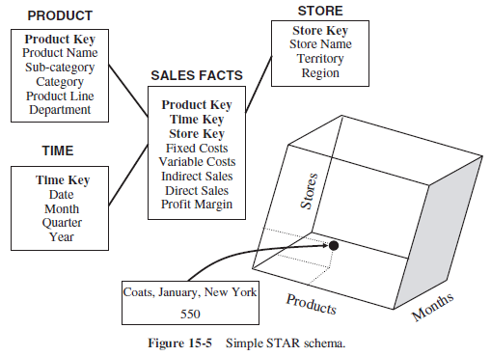
Example: Sales Fact

Slide 8
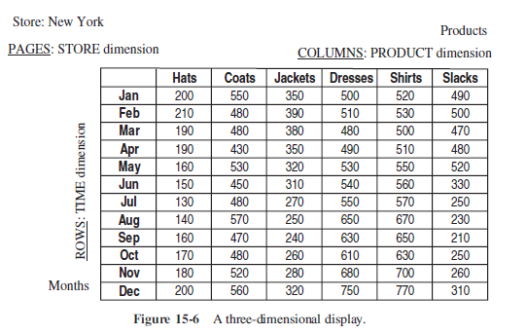
Display Multidimensional Data
We can display the result of a query on the cube by assigning a dimension (at a chosen aggregation level) to columns, rows and pages.

Slide 9
Sample Queries and Results, 1
Display the total sales of all products for past five years in all stores
Rows: year numbers 2011, 2010, 2009, 2008, 2007
Columns: total sales for all products (one column only)
Page: all stores (one page only)
Compare total sales for all stores, product by product, between year 2011 and 2010.
Rows: year numbers 2011, 2010; difference; percentage increase or decrease
Columns: one column per product, showing all product
Page: all stores (one page only)
Show comparison of total sales for all stores, product by product, between year 2011 and 2010 only for those products with reduced sales.
Rows: year numbers 2011, 2010; difference; percentage increase or decrease
Columns: one column per product, showing only the qualifying products
Page: all stores (one page only)

Slide 10
Sample queries and results, 2
Show comparison of sales by individual stores, product by product, between year 2011 and 2010 only for those products with reduced sales.
Rows: year numbers 2011, 2010; difference; percentage increase or decrease
Columns: one column per product, showing only the qualifying products
Page: one store per page
Show the results of the previous query, but rotating and switching the columns with rows.
Rows one row per product, showing only the qualifying products
Columns: year numbers 2011, 2010; difference; percentage increase or decrease
Page: one store per page

Slide 11
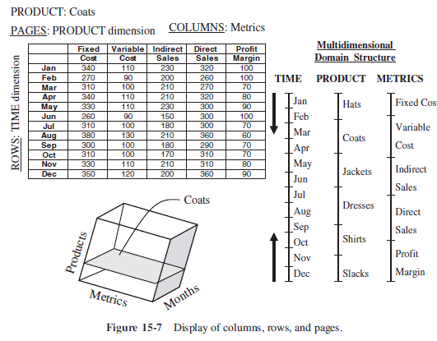
Multiple Measures in the Fact

Slide 12
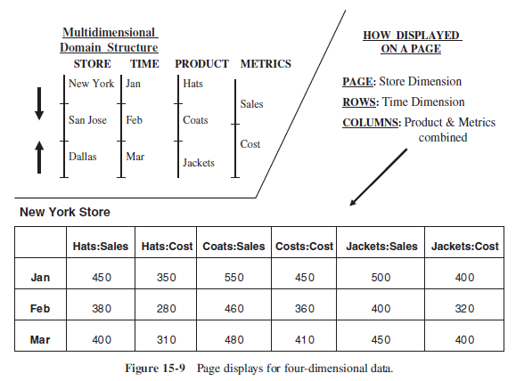
More Dimensions
Display more than one dimensions on an axis

Slide 13
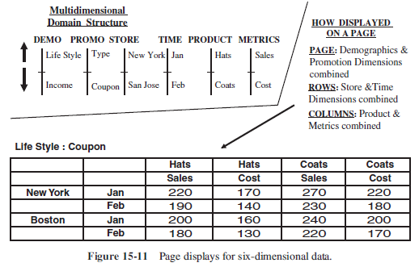
Example: Six Dimensions

Slide 14
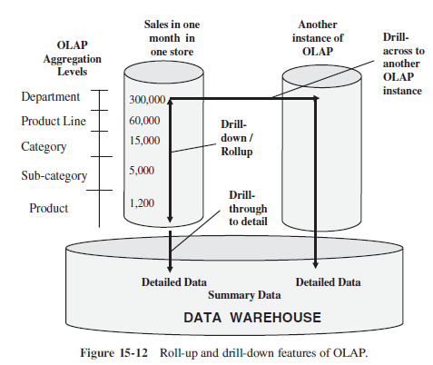
Common OLAP Operators
Rollup along a hierarchy reveals less detail
Drill-down along a hierarchy reveals more detail
Drill-through shows the detail transaction data
Pivoting changes the axis of the multidimensional view
Slicing restricts the data used in calculation

Slide 15
OLAP extension in SQL-99
SQL:1999 (also called SQL 3) was the fourth revision of the SQL database query language.
Extension to GROUP BY clause
ROLLUP produces a result set that contains subtotal rows in addition to the regular grouped rows
CUBE produces a result set that contains all the subtotal rows of a ROLLUP aggregation and, in addition, contains cross-tabulation rows.
Both above are special cases of GROUPING SETS
SQL Extension of PostgreSQL For Multidimensional Analysis
GROUPING SETS
CUBE
ROLLUP
Notes:
http://www.cs.ucla.edu/classes/spring11/cs240B/notes/guion1.pdf
http://docs.oracle.com/cd/E11882_01/server.112/e25554/aggreg.htm
http://wwwlgis.informatik.uni-kl.de/cms/fileadmin/courses/SS2008/NEDM/RDDM.Chapter.06.Windows_and_Query_Functions_in_SQL.pdf

Slide 16
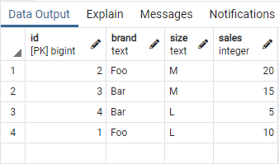
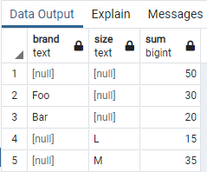
GROUPING SETS
The data selected by the FROM and WHERE clauses is grouped separately by each specified grouping set, aggregates computed for each group just as for simple GROUP BY clauses.
GROUP BY ( )
GROUP BY brand
GROUP BY size
SELECT * FROM item_sold
SELECT brand, size, sum(sales) FROM item_sold GROUP BY GROUPING SETS ((brand), (size),())

Slide 17
ROLLUP (1/3)
ROLLUP is a shorthand notation provided for specifying two common types of grouping set.
A clause of the form ROLLUP (e1, e2, e3, …) represents the given list of expressions and all prefixes of the list including the empty list.
Thus, it is equivalent to GROUPING SETS ( (e1, e2, e3, …), … (e1, e2), (e1), ( ) )
This is commonly used for analysis over hierarchical data; e.g., total salary by department, division, and company-wide total.

Slide 18
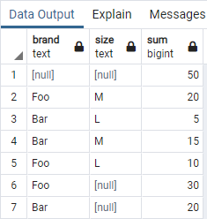
ROLLUP (2/3)
SELECT brand, size, sum(sales) FROM item_sold GROUP BY ROLLUP (brand, size)
SELECT brand size sum(sales) FROM item_sold GROUP BY GROUPING SET ((brand, size), (brand), ())
GROUP BY ( )
GROUP BY brand, size
GROUP BY brand

Slide 19
ROLLUP (3/3)
SELECT P.type, P.product, Sum(F.receipts) as rcpt
FROM SALES F
JOIN STORE S ON F."keyS" = S."keyS"
JOIN DATE D ON F."keyD" = D."keyD"
JOIN PRODUCT P ON F."keyP" = P."keyP"
WHERE D.month = '2010 Jan'
GROUP BY ROLLUP(P.type, P.product);
type | product | rcpt
Dairy | Milk | 105
Dairy | Yogurt | 140
Drink | Coke | 335
Drink | Juice | 305
Dairy | NULL | 245
Drink | NULL | 640
NULL | NULL | 885
Type | Product | Receipts
Dairy | Milk | 105
 | Yogurt | 140
 | Subtotal: | 245
Drink | Coke | 335
 | Juice | 305
 | Subtotal: | 640
 | Total: | 885

Slide 20
CUBE (1/3)
CUBE is a clause of the form CUBE (e1, e2, …) represents the given list and all of its possible subsets (i.e., the power set)
Thus, CUBE(a, b, c) is equivalent to GROUPING SETS ( (a, b, c), (a, b, ), (a, c), (a ), ( b, c), ( b ), ( c), ( ) )

Slide 21
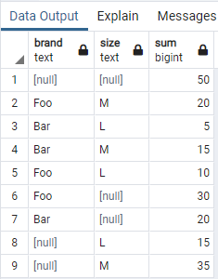
CUBE (2/3)
SELECT brand, size, sum(sales) FROM item_sold GROUP BY CUBE (brand, size)
SELECT brand size sum(sales) FROM item_sold GROUP BY GROUPING SET ((brand, size), (brand), (size), ())
GROUP BY ( )
GROUP BY brand, size
GROUP BY brand
GROUP BY size

Slide 22
CUBE (3/3)
SELECT S.city, P.type, Sum(F.receipts) as rcpt
FROM SALES F
JOIN STORE S ON F."keyS" = S."keyS"
JOIN DATE D ON F."keyD" = D."keyD"
JOIN PRODUCT P ON F."keyP" = P."keyP"
WHERE D.month = '2010 Jan'
GROUP BY CUBE(S.city, P.type);
City | Type | Rcpt
Macau | Dairy | 100
Macau | Drink | 150
HK | Dairy | 300
HK | Drink | 400
Macau | NULL | 250
HK | NULL | 700
NULL | Dairy | 400
NULL | Drink | 550
NULL | NULL | 950
 |  | Product type
 |  | Dairy | Drink | Total
City | Macau | 100 | 150 | 250
 | HK | 300 | 400 | 700
 | Total | 400 | 550 | 950

Slide 23
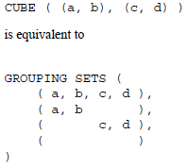
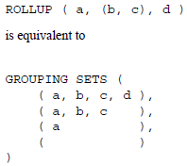
More on RULLUP and CUBE (1/2)
The individual elements of a CUBE or ROLLUP clause may be either individual expressions, or sublists of elements in parentheses
In the latter case, the sublists are treated as single units for the purposes of generating the individual grouping sets.

Slide 24
More on RULLUP and CUBE (2/2)
The CUBE and ROLLUP constructs can be used either directly in the GROUP BY clause, or nested inside a GROUPING SETS clause.
If one GROUPING SETS clause is nested inside another, the effect is the same as if all the elements of the inner clause had been written directly in the outer clause.
For example:
GROUP BY a, CUBE(b, c), GROUPING SETS ((d), (e)) is equivalent to GROUP BY GROUPING SETS ( (a, b, c, d), (a, b, c, e), (a, b, d), (a, b, e), (a, c, d), (a, c, e), (a, d), (a, e) )

Slide 25
TOP N
List the sales amount by product type in the top 4 cities in sales receipts in 2011.
SELECT S.city, P.type, Sum(F.receipts)
FROM SALES F
JOIN STORE S ON F."keyS" = S."keyS"
JOIN DATE D ON F."keyD" = D."keyD"
JOIN PRODUCT P ON F."keyP" = P."keyP"
JOIN (
SELECT S.city, Sum(F.receipts)
FROM SALES F JOIN STORE S ON F."keyS" = S."keyS“ JOIN DATE D ON F."keyD" = D."keyD"
WHERE D.year = '2011’
GROUP BY S.city
ORDER BY Sum(F.receipts) LIMIT 4
) Top4Cities ON S.city = Top4Cities.city
WHERE D.year = '2011'
GROUP BY S.city, P.type;

